Slide 1

Technology Leader of Lithium Titanate Batteries

Slide 2
Contents
01
GCC Introduction
02
GCC LTO Batteries
03
Solutions and Applications
04
Electrification solutions for Stockholm

Slide 3
01
GCC Introduction

Slide 4

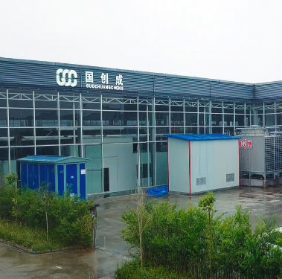
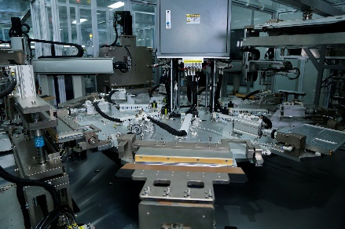
Company Profile
Research Center in Chengdu
Production Base in Meishan
Global Creatives Corporation(GCC) is a company focus on lithium titanate battery and system solutions. The company's product line covers rail transit, intelligent transportation, electric energy storage and other fields.
GCC has 3 research centers in China, include “Batteries and Materials Innovation Center of Sichuan Province”, “Joint Development Center with Chengdu Science and Technology Development Center of China Academy of Engineering Physics”, “Battery Safety Technology Research Center with The Second Research Institute of CAAC”.
ion

Slide 5
02
GCC LTO Batteries

Slide 6
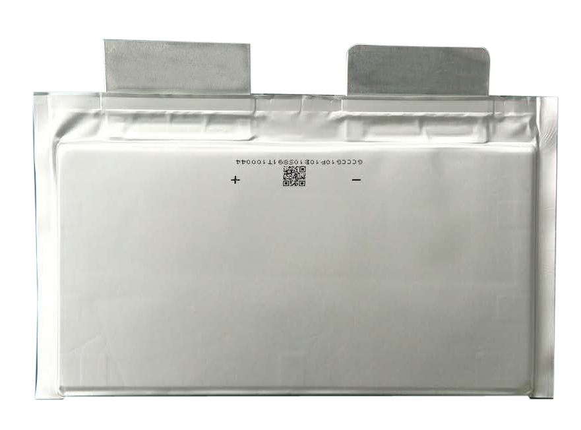

GCC LTO Battery Profile
Product specification manual of LTO battery of GCC
No. | Content | Parameters of LTT65 series | Parameters of LTT90 series
1 | Nominal voltage | 2.35V | 2.35V
2 | Nominal capacity | 15AH | 20AH
3 | Charging voltage | 2.75V | 2.75V
4 | Internal resistance | ＜0.8mΩ | ＜0.5mΩ
5 | Size | width：217±0.1mm | width：217±0.1mm
 |  | height：147±0.1mm （Without tabs 127±0.1mm） | height：147±0.1mm （Without tabs 127±0.1mm）
 |  | thickness：6.5±0.1mm | thickness：9.0±0.1mm
6 | Weight | 345±5g | 495±5g
7 | Weight energy density | 80wh/kg | 100wh/kg
8 | Volume energy density | 250wh/L | 260wh/L
9 | Charge and discharge method | C.C/C.V | C.C/C.V
10 | Charge and Discharge Rate | 0.1~30C | 0.1~30C
11 | Discharge Cutoff Voltage | 1.5V | 1.5V
12 | Overcharge Protection Voltage | 3V | 3V
13 | Over-discharge Protection Voltage | 1V | 1V
14 | Operating Temperature | -40℃~55℃ | -40℃~55℃
15 | Storage Temperature | -30℃~40℃ | -30℃~40℃
16 | Cycle life | Over 20000 times | Over 20000 times
Battery specification
15Ah
20Ah
Long-term operation at
high and low temperature
Intrinsic safety
Extra-long circle life
Charge and discharge at high rate

Slide 7
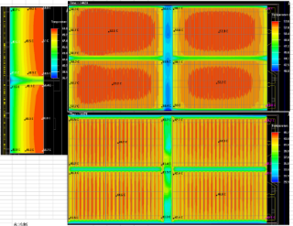
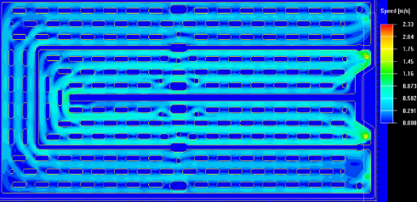
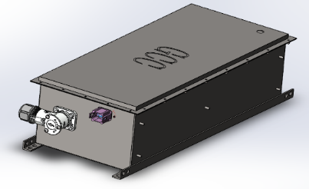
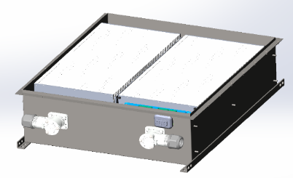
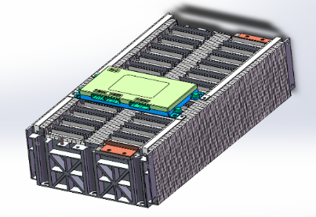
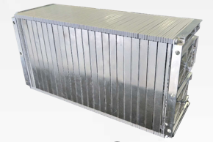
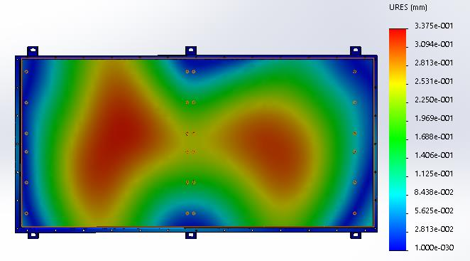
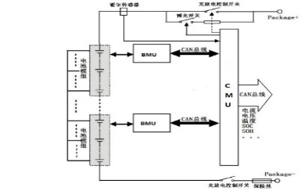
GCC LTO Batteries PACK Technology
Thermal simulation
Flow field simulation
Mechanical simulation
Power management design
Type A/B/C and other size standard box
Advanced design technology of PACK plan
24s, 48s standard module
Structure design
Customized module, Customized box
Flow field design
Smart liquid flame retardance cooling technology,
intelligent air cooling technology
Thermal management design
Power management design
Operating temperature: -40℃—75℃

Slide 8
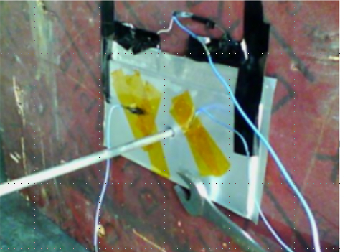
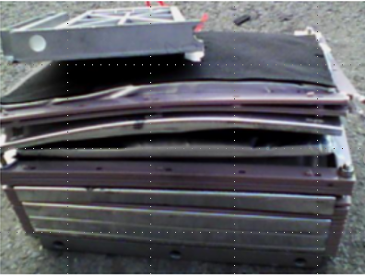
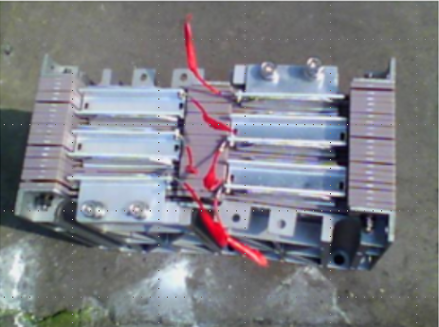
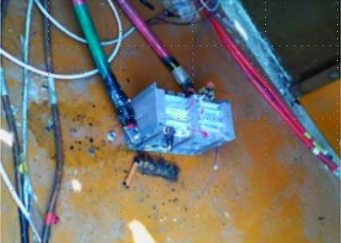
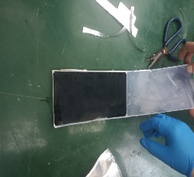
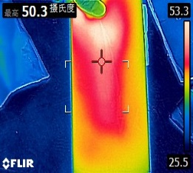
Intrinsic safety
Nail Penetration, Extrusion, and External short circuit test of cell and module, no explosion, no burning
The fully charged battery is disassembled directly in the air, and the lithiated electrode is exposed to the air. The temperature of electrode of GCC LTO battery is lower than 55℃。

Slide 9
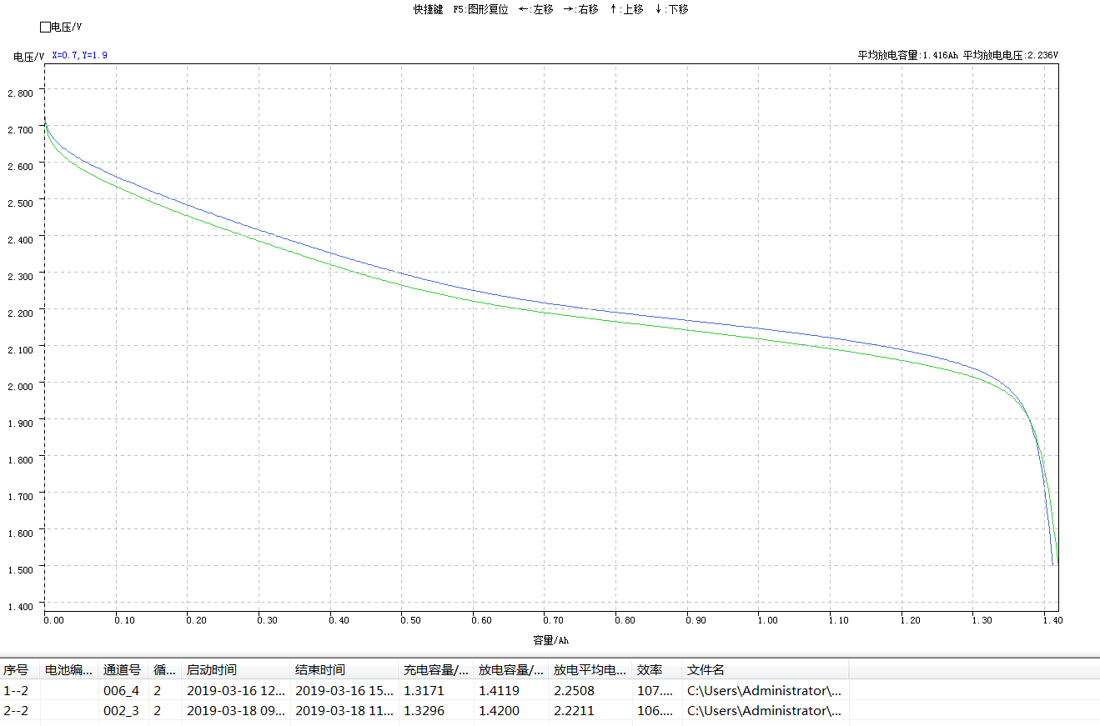
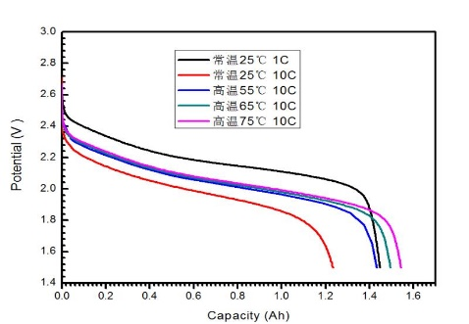
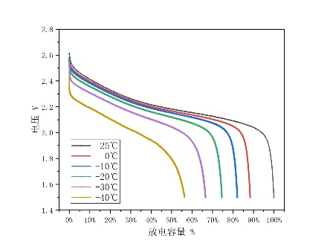
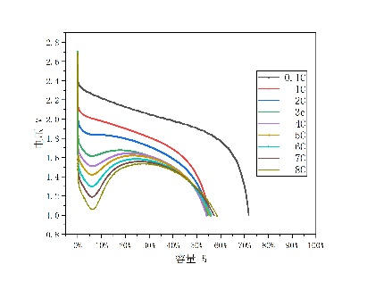
Long-term operation at high and low temperature
Low temperature performance test
High temperature performance test
1/3C discharge rate test
-40℃ discharge test at different rate
The capacity comparison after
recycle 24 hours at 80℃
Normal work at 75℃ high temperature
1/3C discharge rate at -40℃
the capacity still have 55%
8C discharge rate at -40℃,
the capacity still have 55%

Slide 10
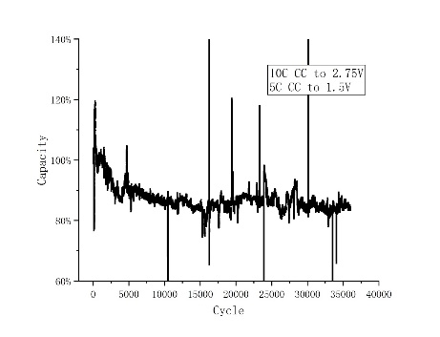
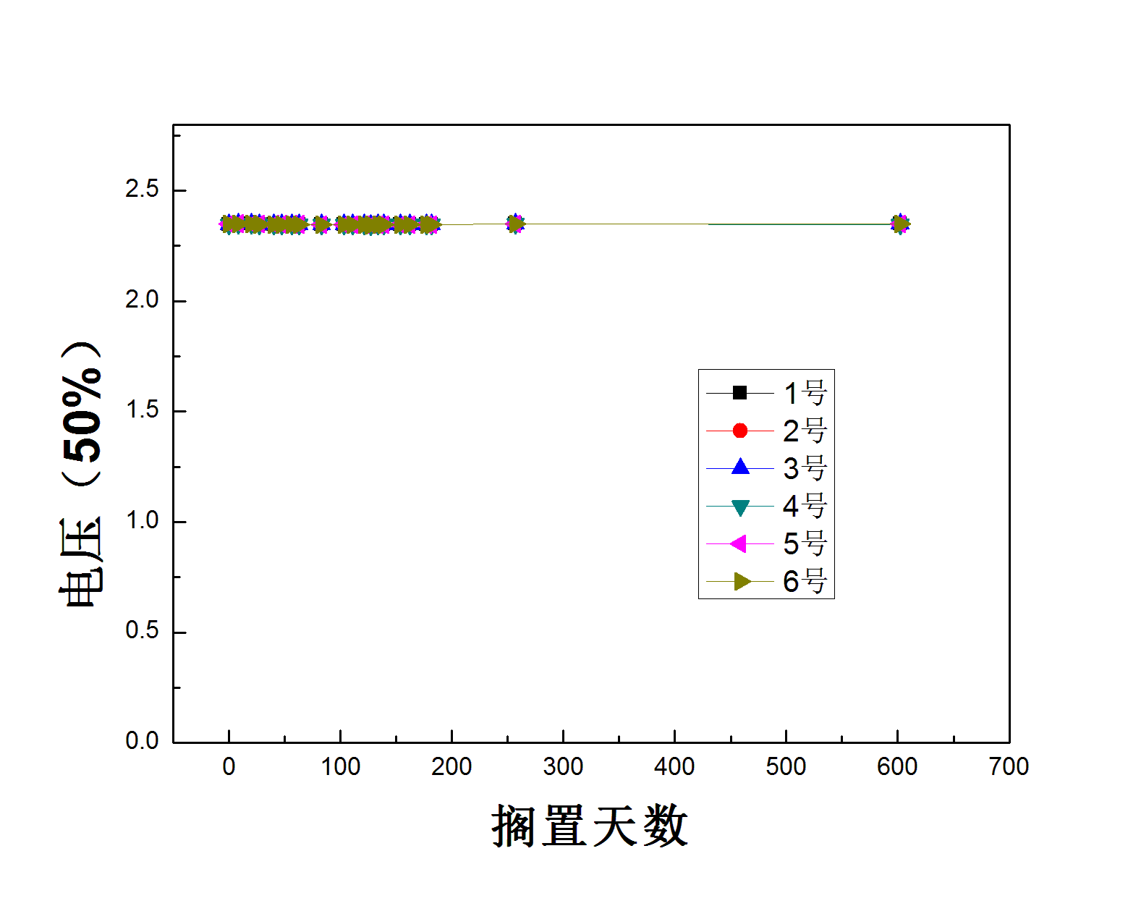
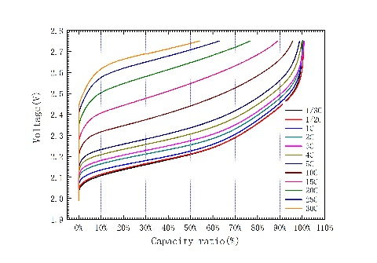
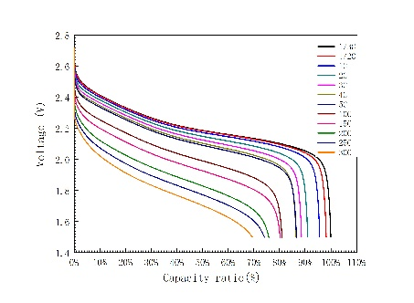
Extra-long circle life
Charge and discharge at high rate
Cycle life test at 25℃ room temperature
Storage life test at 25℃ room temperature
Mass production battery 10C charge and 5C discharge test, over 35,000 cycle life and still testing, capacity is maintained over 85%.
Mass production battery is stored at 25℃ for more than 2 years， the voltage and capacity attenuation is less than 1% per year.
Different charging rate test
Different discharging rate test
Mass production battery can operate at over 30C rate.

Slide 11
03
Solutions and Applications

Slide 12
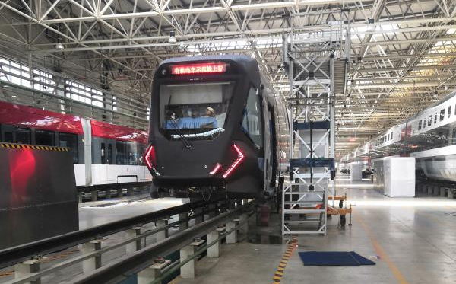
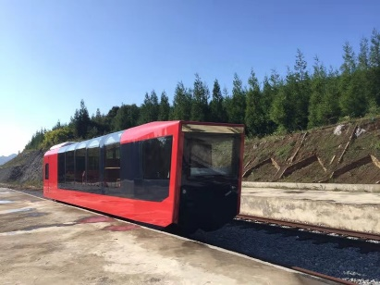




GCC Solution & Application Scenarios
Fast Charging Solution & Application Scenarios
4-20C charging and discharging, finish the charging/discharging in 3-15 minutes
Life circle of battery PACK exceeds 20000 times
High security and reliability
Wide operation temperature range(-40℃ to 55℃）
Applied in bus, city logistics vehicle, light rail, intelligent rail, and so on
Application: Provide power for the intelligent rail and sightseeing train of CRRC, which worked in Sichuan and Guizhou.

Slide 13
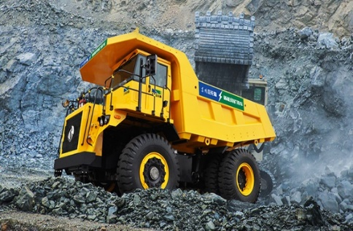
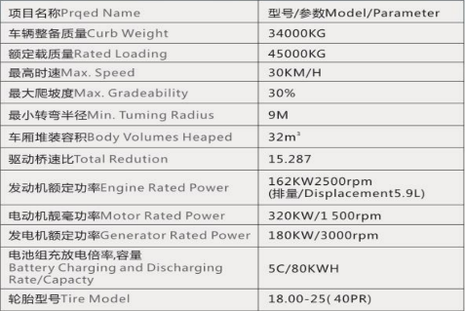
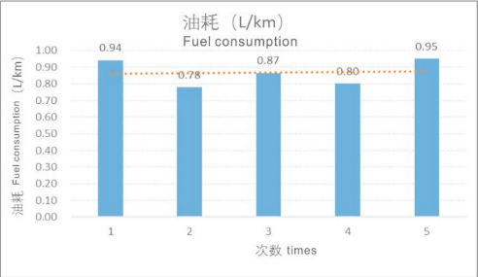
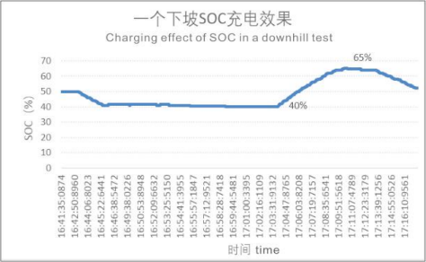
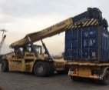
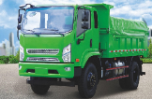
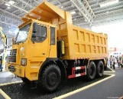
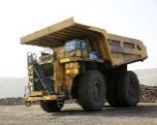
GCC Solution & Application Scenarios
Extended Range Hybrid Solution & Application Scenarios
4-20C charging and discharging to guarantee the power performance
No charging piles needed and do not take up vehicle (mechanical) operation time
Life circle of battery PACK exceeds 20000 times
High security and reliability
Wide operation temperature range(-40℃ to 55℃）
Applied in mine truck, Reach stacker, loader, and other heavy machinery
Application：DF45E New Energy mine truck of Dongfeng Heavy Industry
Fuel saving 50-70%,emission reducing at least 90%,working in a complex mining area. Take 10 million cubic meters of downhill mine as an example, new energy mine trucks can save 150 million to 200 million yuan at total for 10 years. Using such new energy mine truck, the originally lost mine transportation project became a green and profitable project

Slide 14
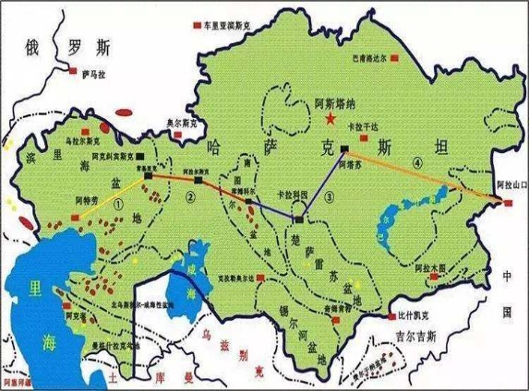
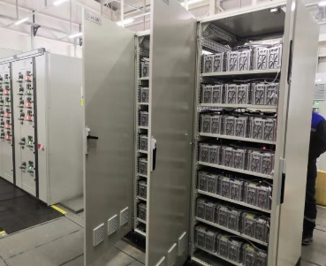
GCC Solution & Application Scenarios
Energy storage Solution & Application Scenarios
The application of energy storage frequency modulation can stabilize the fluctuation of power grid by high rate charge and discharge of lithium titanate battery.
The safety performance of lithium titanate makes it can be used in oil transportation industry.
Application: Transformation of UMD power supply in the CCS4 compressor station in Kazakhstan of SINO-Pipeline International Company

Slide 15
04
Electrification solutions for Stockholm

Slide 16
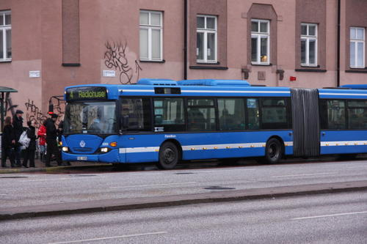

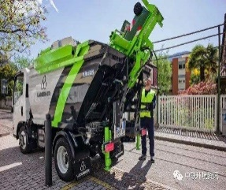
Electrification solutions for Stockholm
2000 bus
300 ferry
500 garbage truck
90,000,000L fuel oil per year
230,000,000KG CO₂ per year
900,000KG SO_{x} per year
760,000KG NO_{x} per year
160,000KG PM per year
Fuel consumption and Exhaust per year
 | bus | ferry | Garbage truck
Fuel oil (L) | 25550 | 109500 | 14600
CO₂ (KG) | 65000 | 280000 | 38000
So_{x} (KG) | 255 | 1100 | 140
No_{x} (KG) | 215 | 940 | 120
PM (KG) | 45 | 200 | 25

Slide 17
Electrification solutions for Stockholm
Public Traffic Electrification solutions
Bus→Fast-charging
Ferry →Fast-charging
Garbage truck →Hybrid
95% reduction in pollution emissions
90,000,000L→3,650,000L fuel oil per year
230,000,000KG →9,500,000KG CO₂ per year
900,000KG →35,000KG SO_{x} per year
760,000KG →30,000KG NO_{x} per year
160,000KG →6,250KG PM per year

Slide 18
Thanks！
Global Creatives Corporation
Add: Ganmei Industrial Park, Meishan, Sichuan, PRC.
Tel: 0086-28-38059922
E-Mail: info@gcctek.com.cn

