Slide 1



Slide 2

CEVT

Slide 3
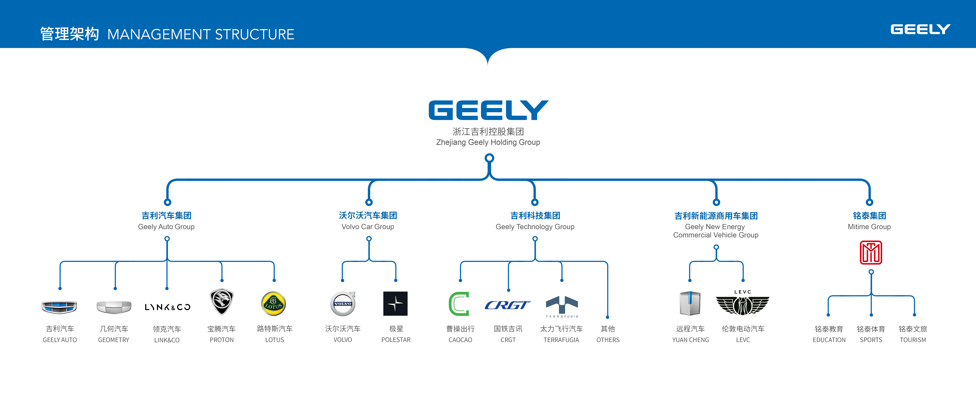

Owned by Zhejiang Geely Holding Group
Gothenburg, Sweden
Delivers technology to all automotive brands

Slide 4
Sustainable Future Mobility

Slide 5

Part of the sustainable society
Adopted to users’ sustainability expectations
Circular business models

Slide 6
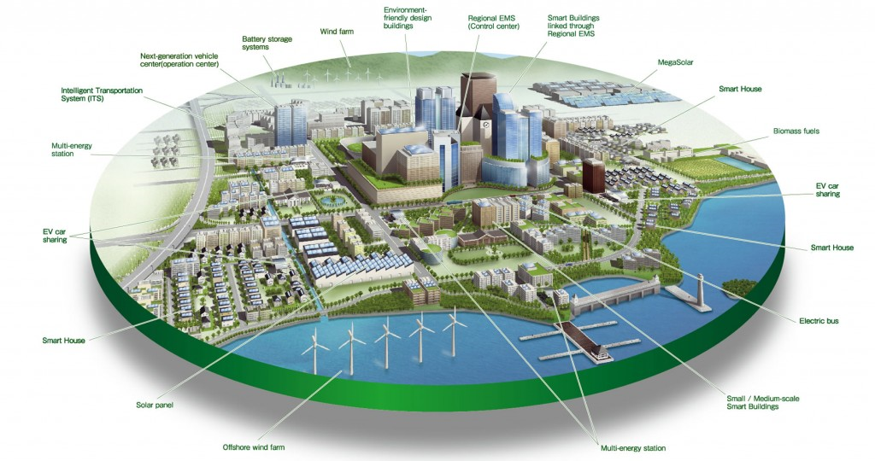
In Future Mobility vehicles become an integrated part in sustainable cities and a sustainable society.
Vehicles become a part of the solution for climate change- not a climate problem

Slide 7








Door-to-Door
?
Personal experience
Business
Simple to Access
Integrated Mobility Service
Available on Request
Reliable and Safe
Adopted to needs
Pleasure
Sustainable and fair
Duration
Luggage
Companions
In Future Mobility customers require sustainable and fair solutions that provide easy accessible
door-to-door service independent of transport solution

Slide 8









Sustainable & fair supply chain
Recyling/reuse
of components
Sustainable & ecofiendly logistics
Alternative use of consumables
Circular & Sustainable business model
Sustainable & fair production
Shared mobility business models
Electrical drivelines
Renewable energy production in vehciels
Ecofiendly materials
In Future Mobility customers and society will require a
circular and sustainable business model

Slide 9
Thank you

